Slide 1
Joint Systems, Man, and Cybernetics/Aerospace & Electronic systems Chapter
21 January 2017
Notes:
Notes:

Slide 2
Leadership Team
Chair – Walt Downing
Vice Chair – Dr. Sos Agaian
Other Officers/Committee Chairs
Secretary/Treasurer – Nils Smith
Notes:
Notes:

Slide 3
SMC28/AES10 Highlights
V-tools Chapter homepage
2015 AESS USA Chapter of the Year
AESS $2,500 Award to Trinity University for 2017 Formula SAE competition
Notes:
Notes:

Slide 4
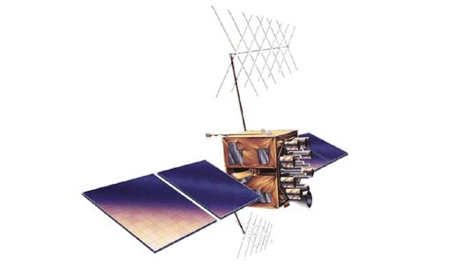
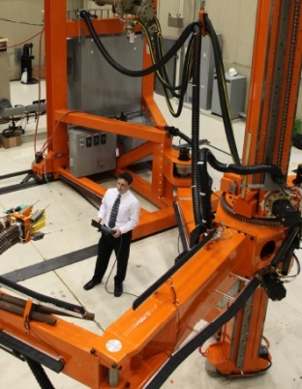
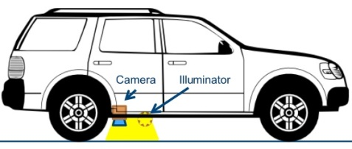
2016 Spring Meetings
22 Jan* (held twice, DL series)
Navigation Sensors and Systems in GNSS Degraded and Denied Environments
23 Feb*
Supersized Robots
10 Mar
Creating a Mobile Platform for Cervical Cancer Diagnosis
28 Apr*
Ranger: A Ground-facing Camera-based Localization System for Ground Vehicles
* also webcast
Notes:
Notes:

Slide 5
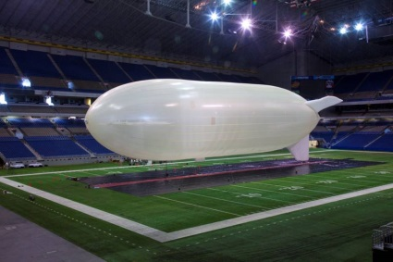
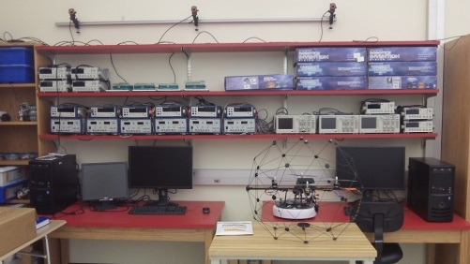
2016 Fall Meetings
19 Sep*
Lighter-Than-Air Systems
30 Sep
Aerodynamics to Aeronautics
14 Oct
UIW AVS Research and Education Laboratory
14 Nov
UTSA Unmanned Systems Lab
29 Nov
UTSA Technology Symposium
Special Recognition Certificates
16 Dec
People, Patents and Politics: Wright Bros. vs Glenn Curtiss – The Patent War
* also webcast
Notes:
Notes:

Slide 6
2017 Plans
17 January
Bridging the Disruptive Technology Valley of Death
Walt Downing, AESS Distinguished Lecturer
February
Engineers Week Meeting - TBD
2&3 March
AESS Gyro and Accelerometer Technical Panel Meeting
April
Trinity University Student Project Update
UTSA Senior Project and CITE Competition
UTSA Distinguished Lecturer Dr. Maruthi Akella 26th @ 5:00 pm

Slide 7
SWOT
Strengths
Frequent Meetings
Strong Connections to AESS Leadership
Weaknesses
Lack of Permanent Meeting Days/locations
Lack of SMC Content
Opportunities
Collaboration with
IEEE Systems Council
AUVSI
AIAA
UIW, Trinity Connections
Threats
Competing time commitments
Notes:
Notes:

Slide 8
QUESTIONS??? Thanks
Notes:
If you’d like to learn more about electronic services, you’ll want to attend the session on the Electronic Services being presented this afternoon by Christian Borgert (BORE-GERT) and Chip Dawson. If you miss this afternoon’s session, you can see it tomorrow morning.
Now I’d like to answer your questions about newsletters and electronic services . . .
(After Q&A)
I’m sorry we don’t have time to answer all of your questions, but we have an abundance of expertise with us this weekend, and much of it is in the Computer Lab upstairs. Stop by and get more information anytime.

